Slide 1

SECURE DATA COMMUNICATION IN WIRELESS LANs USING TRANSPORT LAYER SECURITY (TLS)
CSA0764 – COMPUTER NETWORKS FOR A GAME SERVER
UNDER THE SUPERVISION OF
DR.K.SENTHIL
DR.P.RAJARAM
PRESENTED BY
G.SANJANA(192511020)
M.VAISHALI(192524440)
B.SREYA(192521442)

Slide 2

INTRODUCTION
Wireless LANs (WLANs) have become an essential part of modern communication, enabling users to access the internet without the constraints of physical cables. Because WLAN signals are transmitted through the air, attackers can easily intercept the data
Sensitive information like passwords, banking data, and personal messages must be protected from unauthorized access.
Secure communication, security protocols must be applied at different layers of the OSI model. One of the most powerful and widely used protocols is Transport Layer Security (TLS).
TLS provides authentication, encryption, and data integrity

Slide 3
OBJECTIVES
Clear Goals
Design a secure wireless LAN communication system using Transport Layer Security (TLS)
Implement TLS to encrypt data and authenticate users and servers
Ensure secure, reliable, and efficient data transmission over Wi-Fi networks
Address the Problem Statement
Protect wireless data from eavesdropping and unauthorized access
Prevent data tampering and identity spoofing in WLAN communication
Enhance security without significantly affecting network performance
Expected Outcomes
Secure wireless communication with encrypted data transmission
Verified authentication using digital certificates and TLS handshake
Improved data integrity and confidentiality with minimal performance overhead

Slide 4
LITERATURE REVIEW / BACKGROUND
Title / Area | Authors | Year | Methodology Used | Key Contributions
Optimizing TLS Performance in Wireless Networks | Zhang, L. & Kumar, S. | 2025 | Experimental analysis using TLS handshake optimization and performance testing | Reduced TLS handshake delay and improved secure communication efficiency in WLANs
Secure Wi-Fi Communication Using TLS 1.3 | Hernandez, R., Gomez, A., et al. | 2025 | Simulation-based evaluation of TLS 1.3 over wireless networks | Achieved faster connection setup and stronger encryption for Wi-Fi communication
Lightweight TLS for IoT Devices over WLAN | Park, J. & Lee, H. | 2025 | Design and implementation of lightweight TLS protocol with performance benchmarking | Enabled secure communication for low-power IoT devices with minimal overhead
EAP-TLS Based Authentication in Wireless LANs | Singh, A. & Patel, R. | 2025 | Certificate-based authentication testing using EAP-TLS framework | Improved user and device authentication security in WLAN environments
Encrypted Traffic Protection in Wireless Networks | Miller, T. & Brown, D. | 2025 | Traffic analysis of TLS-encrypted wireless data streams | Demonstrated enhanced privacy and confidentiality in wireless communication

Slide 5
Theoretical Foundation
Network Security Theory – explains how confidentiality, authentication, and integrity protect data during communication.
Cryptography Principles – explains symmetric encryption, asymmetric encryption, and hashing used in TLS.
TLS Protocol Theory – explains the TLS handshake, key exchange, and secure session establishment.
OSI Model Concept – explains how TLS operates between the Application and Transport layers to secure data transmission.
Research Gap
Most studies focus on wired networks or web applications, with limited emphasis on TLS implementation in wireless LAN environments.
Limited practical work demonstrates end-to-end TLS deployment over Wi-Fi, including handshake, authentication, and performance evaluation.
Our project fills this gap by implementing and analyzing TLS-based secure communication in WLANs with real-time testing and performance observation.

Slide 6
Methodology
1. Tools & Frameworks Used
Cisco Packet Tracer / Wi-Fi Network Setup for designing and simulating the wireless LAN environment.
Web Server with TLS (HTTPS) for implementing secure communication using TLS.
Client Devices (PC/Laptop) for accessing the wireless network and testing secure data transfer.
Digital Certificates for server authentication and secure key exchange.
Development Approach
Followed a step-by-step approach:
Designed a wireless LAN with access point and client devices.
Configured the server to support TLS-based HTTPS communication.
Established TLS handshake between client and server.
Enabled encrypted data transmission over the WLAN.
Verified secure connection and tested end-to-end communication.
Used an iterative test-and-validate cycle to ensure secure data transfer at each stage.
Data Collection
Verified secure communication using HTTPS connection status.
Observed TLS handshake and certificate details during connection.
Tested connectivity and response using browser access and network tools.
Captured key screenshots of secure sessions and configurations for documentation.

Slide 7
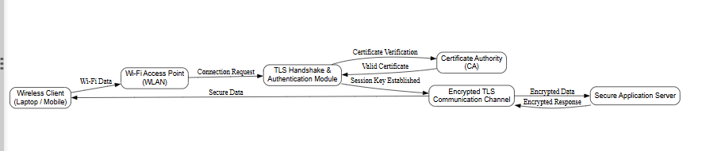
System Architecture
The client connects to the WLAN through an access point
The server supports TLS
TLS handshake establishes a secure session
Encryption keys are exchanged
All data is securely transmitted over the wireless network
This architecture ensures end-to-end security.

Slide 8
Implementation
Module 1: TLS Protocol Implementation
Device Type | Model / Details | Purpose
Wireless Access Point | PT-AP / Wireless Router | Provides Wi-Fi connectivity
Server | PT Server (HTTPS enabled) | Hosts secure TLS service
Client Devices | PC / Laptop | Access secure wireless network
Network Cables | Straight-through | Connects server to router
Digital Certificates | TLS Certificates | Enables authentication & encryption
Implementation Steps
Designed a wireless LAN topology with Access Point, server, and clients
Configured the server to support HTTPS using TLS
Installed and verified digital certificates on the server
Connected client devices to the WLAN
Initiated TLS handshake between client and server
Established encrypted session and transmitted data securely over Wi-Fi

Slide 9
Module 2:Secure Transmission Techniques Using TLS
Secure Transmission
Encryption of Data
TLS encrypts all data before transmission, converting it into unreadable cipher text to protect sensitive information from eavesdropping.
TLS Handshake Mechanism
A secure handshake process is used to authenticate the server and generate secret session keys before data transfer begins.
Digital Certificate Authentication
TLS uses digital certificates issued by trusted Certificate Authorities to verify the identity of the server.
Secure Key Exchange
Encryption keys are securely exchanged using asymmetric cryptography, and symmetric keys are used for fast data transmission.
Data Integrity Checks
Hashing and message authentication codes (MACs) ensure that data is not altered during transmission.
Session Management
Secure sessions are maintained throughout communication, preventing replay attacks and unauthorized access.

Slide 10
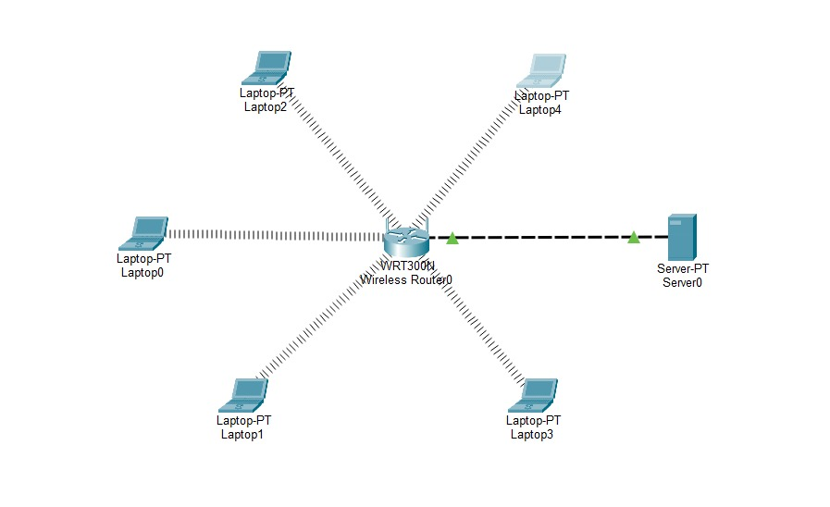

Slide 11
Module 3:Ensuring Secure Wireless LAN Transmission
Key Features
Verified TLS secure connection establishment
  HTTPS enabled
  TLS handshake successful
Server authentication verified using digital certificates
Encrypted data transmission confirmed over wireless LAN
Client-to-Server secure communication tested successfully
Verification Details
Confirmed HTTPS lock symbol in browser
Checked TLS certificate details (issuer, validity, encryption)
Observed secure session establishment before data transfer
Verified data confidentiality and integrity during transmission
Performance Observation
Slight delay during initial TLS handshake
Normal response time after secure session establishment
No packet loss or data corruption observed

Slide 12
Results & Discussion
Outcomes of the Project
Successfully implemented secure wireless LAN communication using TLS.
Data transmitted between wireless client and server was encrypted, ensuring confidentiality.
Server authentication using digital certificates prevented unauthorized access.
Secure communication was maintained even over an open or shared wireless medium.
TLS effectively protected data against eavesdropping and tampering attacks.
Feature | Normal Wireless LAN | TLS-Enabled Wireless LAN (Our Project)
Data Security | Plain text transmission | Fully encrypted transmission
Authentication | Basic (SSID/password) | Strong server authentication using certificates
Data Integrity | No integrity check | Ensures data integrity using hashing
Attack Resistance | Vulnerable to sniffing & MITM | Protected against eavesdropping & MITM attacks
Scalability | Limited security scalability | Easily scalable with TLS certificates
Key Advantages
Enhanced security with minimal performance overhead, providing encrypted communication, data integrity, and authentication without major changes to existing WLAN infrastructure.

Slide 13
Future scope
Enhancements / Improvements
Upgrade implementation to TLS 1.3 for faster handshake and improved security.
Integrate automated certificate management (ACME, auto-renewal) to reduce manual effort.
Implement mutual TLS (mTLS) for stronger client and server authentication.
Add performance monitoring tools to analyze encryption overhead and latency.
Enhance wireless security by combining TLS with WPA3-Enterprise.
How the Project Can Be Extended Further
Extend the setup to a large-scale enterprise WLAN with multiple access points.
Integrate IDS/IPS systems to detect attacks on encrypted traffic patterns.
Apply TLS security to IoT devices connected over wireless networks.
Combine TLS with VPN and Zero Trust Architecture (ZTA) for layered security.
Enable real-time logging and analytics for long-term security auditing and compliance.

Slide 14
Challenges & Limitations
Issues Faced During Development
Configuring TLS certificates and enabling HTTPS on the server required careful setup and validation.
Certificate trust issues occurred when clients did not recognize self-signed certificates.
Wireless packet capture limitations made it difficult to visibly observe encrypted payloads in simulation tools.
TLS handshake introduced initial connection delay due to key exchange and encryption processes.
Compatibility issues were faced with older clients or browsers that do not fully support modern TLS versions.
Possible Constraints
Performance overhead due to encryption and decryption, especially on low-end devices.
Certificate management complexity, including renewal and revocation.
Limited visibility into encrypted traffic complicates network monitoring and debugging.
Dependence on proper time synchronization for certificate validation.
Simulation-based implementation does not fully reflect real-world wireless interference and attacks.

Slide 15
Conclusion
Key Takeaways:
Secure WLAN Communication – TLS enables secure end-to-end communication over wireless networks by encrypting transmitted data.
Data Confidentiality & Integrity – Encryption and message authentication codes ensure that data is protected from unauthorized access and modification.
Authentication Mechanism – Digital certificates verify the identity of clients and servers, preventing impersonation attacks.
Practical Security Implementation – Demonstrates real-time use of TLS in WLANs using standard networking tools and protocols.
Scalability & Applicability – The approach can be extended to enterprise Wi-Fi networks, public hotspots, and IoT wireless systems.
Conclusion :
The project demonstrates that secure data communication in Wireless LANs can be effectively achieved using Transport Layer Security (TLS) without requiring complex or expensive infrastructure. By implementing TLS over a wireless network, the system ensures data confidentiality, integrity, and authentication between communicating devices. The use of encryption, certificate-based authentication, and secure session establishment protects data from common WLAN threats such as eavesdropping, man-in-the-middle attacks, and packet tampering. This implementation provides a strong practical foundation for understanding secure wireless communication in real-world network environments.

Slide 16
REFERENCES:
Zhang, P., Yang, Y., Zheng, Y. and Sun, Y., 2025. Multiplexed Internet of Things Data Transmission and Visualization Utilizing Wireless LAN Authentication and Privacy Infrastructure Protocol in Smart Factories. Sensors, 25(10), p.3134.
Nafees, M. and Kumar, A., 2025. Physical layer security in ambient backscatter communication: A review. Emerging Trends in Computer Science and Its Application, pp.18-25.
Ferst, M.K., Denardin, G.W., Stein, C.M.O., Carati, E.G., da Costa, J.P. and Cardoso, R., 2025. Implementation and Analysis of a Secure Communication with SunSpec Modbus and Transport Layer Security Protocols for Short-term Energy Management Systems. IEEE Access.
Qiao, Z., Wang, Z., Zhou, Y., Yu, Y. and Zheng, D., 2025. MRDT: An Enhanced Multi-Receiver Secure Data Transmission Protocol for WBANs. IEEE Internet of Things Journal.
Li, Y., Khan, F., Ahmed, M., Soofi, A.A., Khan, W.U., Sheemar, C.K., Asif, M. and Han, Z., 2025. RIS-based Physical Layer Security for Integrated Sensing and Communication: A Comprehensive Survey. IEEE Internet of Things Journal.

Slide 17
THANK YOU

